Slide 1

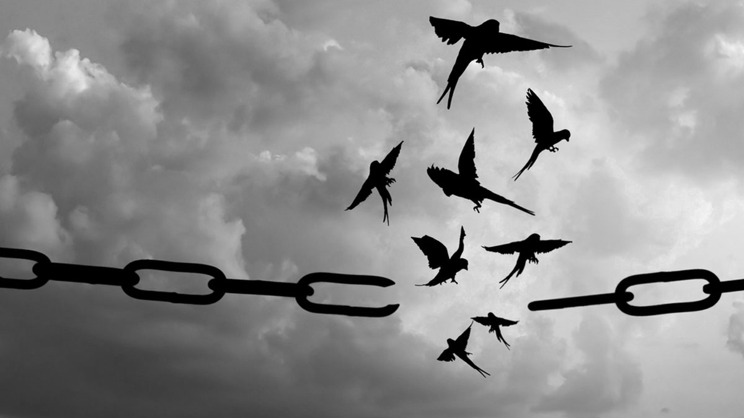

The MINDSET
Shift
Break Through Your Mental Blocks and Develop Strategies and Habits for Lasting Success
Notes:
1

Slide 2
MODULE 3
Resolving Emotional Blocks
Notes:
1

Slide 3
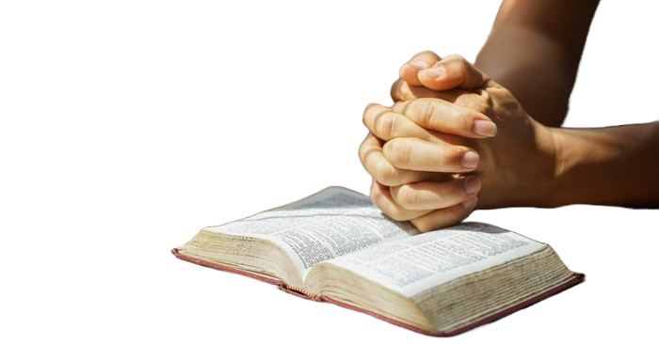


We’ve been looking at why it is important for us to renew our mind.
When we’re trying to shift our mindset… there is a block in our emotions.
We all carry emotional baggage.
When they go unresolved, they become a big block for us.
What is the work of the Spirit… to help us resolve these emotional blocks.

Slide 4
Galatians 5:22–23 (NKJV)
But the fruit of the Spirit is love, joy, peace, longsuffering, kindness, goodness, faithfulness,
gentleness, self-control. Against such there is no law.
God has already given us the tools to deal with these unresolved emotions. Through walking with the Holy Spirit, we can practise these fruits.

Slide 5
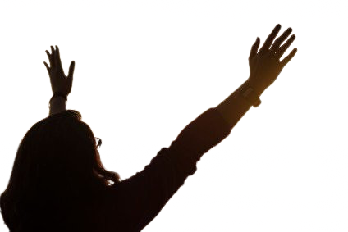
1. Fruit of Love
(Releasing Fear, Rejection, and Shame)
There is no fear in love; but perfect love casts out fear, because fear involves torment. But he who fears has not been made perfect in love. — 1 John 4:18 (NKJV)
He who fears has not been made perfect in love. Fear creates this prison of our mind that love moves against so strongly.

Slide 6
For God has not given us a spirit of fear, but of power and of love and of a sound mind.
— 2 Timothy 1:7 (NKJV)
When love moves in our lives, we stop focusing on pleasing people and start focusing on God. Rejection becomes less important. Love perseveres and helps overcome people pleasing and shame, which are fear responses.

Slide 7
What this resolves:
fear of failure, people-pleasing, rejection wounds.
Important keys:
Fear survives where love is doubted.
Shame blocks bold decisions and clear communication.
Receiving God’s love restores identity and authority.

Slide 8
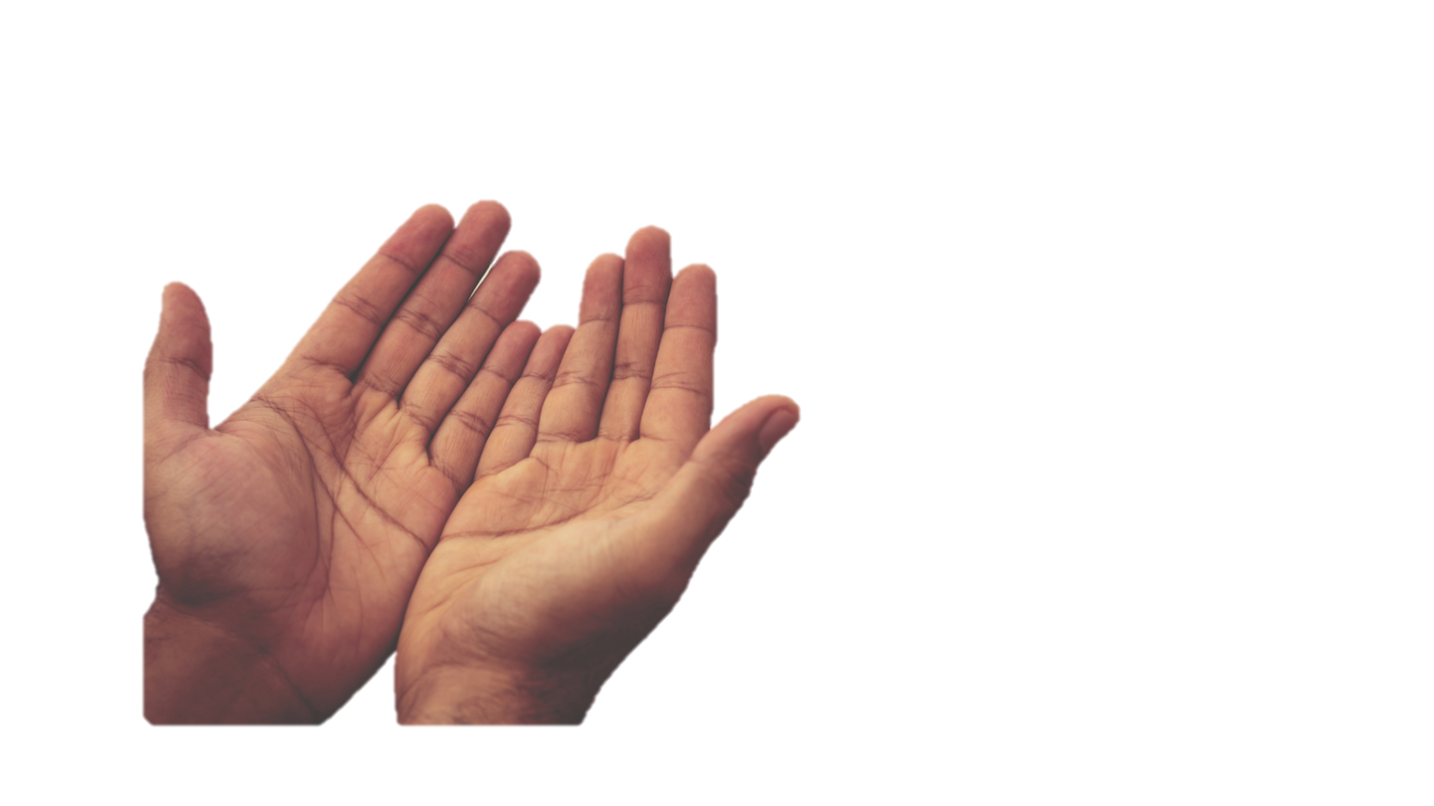
2. Fruit of Joy
(Breaking Heaviness and Emotional Exhaustion)
Then he said to them, “Go your way, eat the fat, drink the sweet, and send portions to those for whom nothing is prepared; for this day is holy to our Lord. Do not sorrow, for the joy of the Lord is your strength.” — Nehemiah 8:10 (NKJV)
They had been mourning and were emotionally exhausted. They were reminded to celebrate what God had done in freeing them from bondage. Joy strengthens people after seasons of sorrow and heaviness.

Slide 9
To console those who mourn in Zion, to give them beauty for ashes, the oil of joy for mourning, The garment of praise for the spirit of heaviness; that they may be called trees of righteousness, the planting of the Lord, that He may be glorified.” — Isaiah 61:3 (NKJV)
Joy breaks emotional exhaustion and heaviness. It brings praise that honours God. Like a tree planted by streams of water, joy helps believers stay strong and refreshed.

Slide 10
Now David was greatly distressed, for the people spoke of stoning him, because the soul of all the people was grieved, every man for his sons and his daughters. But David strengthened himself in the Lord his God. —1 Samuel 30:6 (NKJV)
David chose to strengthen himself in the Lord. This happened during a time of burnout and discouragement. Strengthening himself in God helped him rise again and move forward. Joy became his strength.

Slide 11
What this resolves:
burnout, discouragement, emotional numbness.
Important keys:
Joy is strength, not mood.
Heaviness clouds vision and slows momentum.
Joy refuels faith for the long game.

Slide 12
3. Fruit of Peace
(Calming Anxiety and Mental Noise)
And the peace of God, which surpasses all understanding, will guard your hearts and minds through Christ Jesus.
— Philippians 4:7 (NKJV)
True peace comes from God and calms anxiety and mental noise. Business people often have busy minds, but peace restores clarity and helps with right decision-making.

Slide 13
What this resolves:
anxiety, overthinking, decision paralysis.
Important keys:
Anxiety hijacks focus and drains energy.
Peace guards both heart and mind.
Peace restores clarity for right decisions.

Slide 14
4. Fruit of Patience
(Healing Frustration and Impulsiveness)
And the peace of God, which surpasses all understanding, will guard your hearts and minds through Christ Jesus.
— Philippians 4:7 (NKJV)
True peace comes from God and calms anxiety and mental noise. Business people often have busy minds, but peace restores clarity and helps with right decision-making.

Slide 15
What this resolves:
rushing, quitting too early, reactive choices.
Important keys:
Frustration often comes from unmet expectations.
Impatience creates costly shortcuts.
Patience builds endurance and trust.

Slide 16
5. Fruit of Kindness
(Softening Hardness and Bitterness)
And be kind to one another, tenderhearted, forgiving one another, even as God in Christ forgave you.
— Ephesians 4:32 (NKJV)
Kindness is how we treat others. Forgive one another, because in that forgiveness, hardness gets softened and bitterness gets released.

Slide 17
And the second is like it: ‘You shall love your neighbor as yourself.’
—Matthew 22:39 (NKJV)
But I say to you, love your enemies, bless those who curse you, do good to those who hate you, and pray for those who spitefully use you and persecute you, — Matthew 5:44 (NKJV)
“If your enemy is hungry, feed him; If he is thirsty, give him a drink; For in so doing you will heap coals of fire on his head.” — Romans 12:20 (NKJV)
Kindness actively disarms the emotional resistance that we have to building those relationships. And forgiveness unlocks emotional freedom.

Slide 18
What this resolves:
bitterness, harsh self-talk, relational tension.
Important keys:
Bitterness hardens vision and relationships.
Kindness disarms emotional resistance.
Forgiveness unlocks emotional freedom.

Slide 19
6. Fruit of Goodness
(Confronting Guilt and Self-Condemnation)
Surely goodness and mercy shall follow me all the days of my life; And I will dwell in the house of the Lord forever.
— Psalm 23:6 (NKJV)
Goodness involves doing the right thing.

Slide 20
There is therefore now no condemnation to those who are in Christ Jesus, who[a] do not walk according to the flesh, but according to the Spirit. — Romans 8:1 (NKJV)
Accepting Christ’s forgiveness is essential. Walking in goodness means following the Holy Spirit’s leading and living without condemnation.

Slide 21
What this resolves:
guilt, self-sabotage, feeling “unworthy”.
Important keys:
Guilt keeps people stuck in the past.
God’s goodness redefines self-worth.
Identity fuels healthy action.

Slide 22
7. Fruit of Faithfulness
(Overcoming Inconsistency and Doubt)
Your kingdom is an everlasting kingdom, and Your dominion endures throughout all generations. — Psalm 145:13 (NKJV)
God is forever faithful. In business, inconsistency often comes from doubt.

Slide 23
Through the Lord’s mercies we are not consumed, Because His compassions fail not. They are new every morning; Great is Your faithfulness. — Lamentations 3:22-23 (NKJV)
God's faithfulness models stability over the long term, showing that he renews his mercy every morning.

Slide 24
What this resolves:
stop-start progress, quitting cycles.
Important keys:
Inconsistency often comes from internal doubt.
God’s faithfulness models stability.
Small faithful steps compound over time.

Slide 25
8. Fruit of Gentleness
(Healing Control and Emotional Defensiveness)
“Now I, Paul, myself am pleading with you by the meekness and gentleness of Christ—who in presence am lowly among you, but being absent am bold toward you
— 2 Corinthians 10:1 (NKJV)
This shows Paul responding with gentleness. Gentleness is strong and bold, not weak.

Slide 26
“Behold, I send you out as sheep in the midst of wolves. Therefore, be wise as serpents and harmless as doves. — Matthew 10:16 (NKJV)
Gentleness helps repair relationships and prevents defensive reactions. Strength and softness can exist together.

Slide 27
What this resolves:
control issues, defensiveness, pride wounds.
Important keys:
Control is often fear in disguise.
Gentleness creates safety for growth.
Strength and softness can coexist.

Slide 28
9. Fruit of Self-Control
(Breaking Emotional Reactivity)
“Whoever has no rule over his own spirit is like a city broken down, without walls. — Proverbs 25:28 (NKJV)
Self-control is discipline. Creating habits, creating a lifestyle, a routine, that helps break the reactivity that we have from our emotions.

Slide 29

So then, my beloved brethren, let every man be swift to hear, slow to speak, slow to wrath; for the wrath of man does not produce the righteousness of God. — James 1:19-20 (NKJV)
This teaches being slow to speak and slow to anger. Emotional reactivity damages authority. Self-control protects business momentum and builds trust.

Slide 30
What this resolves:
emotional outbursts, impulsive decisions.
Important keys:
Emotional reactions leak authority.
Self-control protects momentum.
Discipline restores confidence and trust.

Slide 31
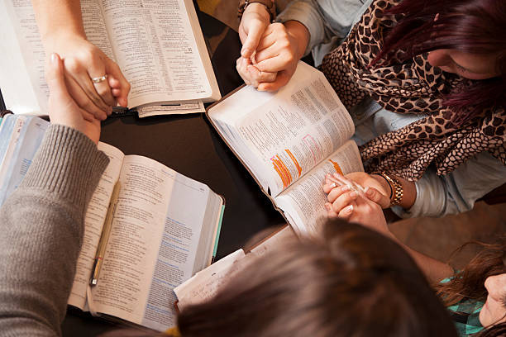
.
Action Steps:
Write down one recurring emotion that keeps showing up (fear, anxiety, frustration, guilt).
Match that emotion to the fruit of the Spirit that counters it.
Speak the verse daily, then take one aligned action (even small).
Note what changes in clarity, peace, or decision-making over the week.

