Slide 1

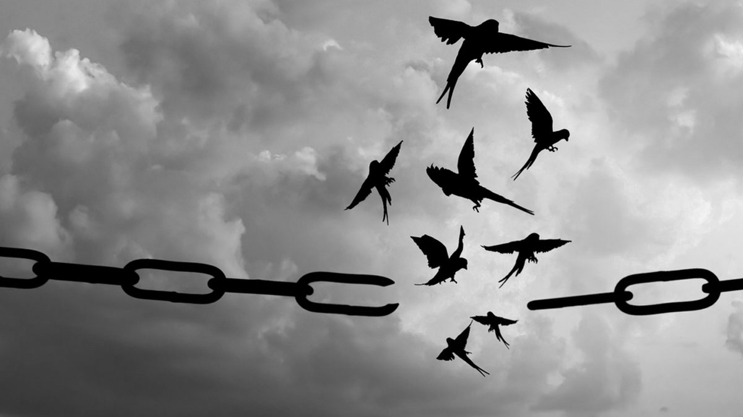

The MINDSET Shift
Break Through Your Mental Blocks and Develop Strategies and Habits for Lasting Success

Slide 2
What Success Means to You
Module 1

Slide 3
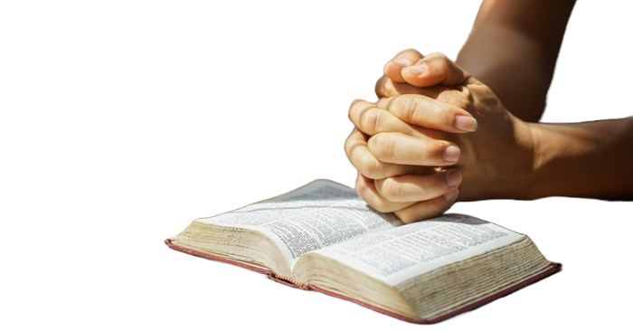

Romans 12:2
Do not conform to the pattern of this world, but be transformed by the renewing of your mind. Then you will be able to test and approve what God’s will is – his good, pleasing and perfect will.
We need to make a shift from this worldly pattern into a Kingdom mindset – the mind of Christ that we’ve been give.

Slide 4

“God calls us to the higher standard. Blessed are the poor in spirit.”
Blessed are the poor in spirit, for theirs is the kingdom of heaven. – Matthew 5:3

Slide 5
In Joshua 1:8 gives us a clear picture of what God is looking for us.
”Keep this book of the Law always on your lips; meditate on it day and night, so that you may be careful to do everything written in it. Then you will be prosperous and successful.”
We’ve got to make sure that the definition of success is God’s definition, not ours.

Slide 6
What does Kingdom success mean to me?
As a business owner, you’ve had many moments of victory where you can see God’s hand in your life.
Maybe a client who suddenly said yes, when you thought, they were going to say no or maybe you’re praying into a particular problem, and a breakthrough came through to solve that problem. Maybe it was an inspirational idea, which came after prayer and seeking the Lord. And maybe it was simply something quiet, like the testimony of a client who is grateful for what you've done for them.

Slide 7
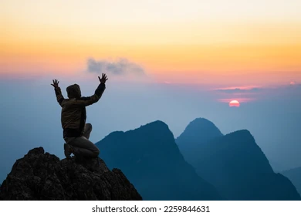
How do you see his faithfulness in your business?
How does it impact your life day to day?
How does it impact your faith?
When have you felt successful but not fulfilled?

Slide 8
When you start to recognise these areas where God has been faithful, we're going to pause for a moment and answer that question.
The reason that this is so important is because we need to understand the difference between that feeling of success and the true fulfilment that comes from walking in God's design for your life.

Slide 9

How might God define success in your current season?
What success is in one season is different in another season. Different seasons have different measures of success.

Slide 10
Do you have a false measure of success that you need to release?
We don't measure it in terms of how many people we are impacting positively with our business. What about the growth of your employees? We're called to make disciples, and business is the place where we can do that.

Slide 11
When we get a clear and precise idea of what kingdom success means, what we see is a kingdom mentality that comes out of that. So, we start taking action that lines up with that mindset.

Slide 12
What Kingdom success mean for you?

Slide 13
Kingdom success could mean:
Building a business that funds Kingdom projects
Serves my clients with excellence
Gives you time to disciple your family
Creating work that advances God’s kingdom, equips others, and leads people to Christ

Slide 14
Kingdom success could mean:
Trusting God with your results
Staying obedient to His leading
Using your business as a platform for impact

Slide 15
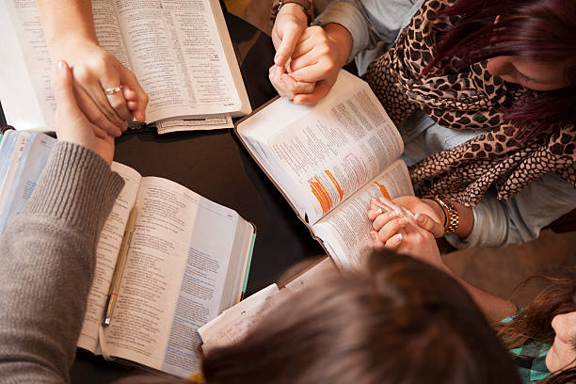
.
2 Corinthians 10:5
”We demolish arguments and every pretension that sets itself up against the knowledge of God, and we take captive every thought to make it obedient to Christ.”
If we don't closely examine our thinking, we can unknowingly get stuck in a mental loop that reinforces that thinking. Often that loop is driven by fear, by disappointment or even a belief that we're on our own when there are people around us that God's placed in our lives. The enemy wants us to keep on reinforcing those same worldly patterns in our minds.

Slide 16
.
What we need to do is we need to replace the self-defeating loops with God's truth. Let’s again return to Romans 12:2.
Reinforce it with reality. It's going to take a bit of effort. But God meets us there. He renews our minds and empowers us to move forward. And when your business stops being run from a place of fear and starts operating from a place of faith and purpose imagine what God can do in partnership in that place.

Slide 17
.
Remember, seek first God's definition of success. Make sure that it's kingdom based, kingdom orientated.
Matthew 6:33, “But seek first His Kingdom and His righteousness, and all these things will be given to you as well.

Slide 18
.
Momentum Challenge 🔥
Reflect and Journal. Create a Kingdom success statement. Write down a time when you saw God's faithfulness in your life or on your business. Include what you saw, heard or felt in that moment whatever you connect with.

